Slide 1
Millenials & elections
Ted Mellnik @tmellnik @PostGraphics

Slide 2
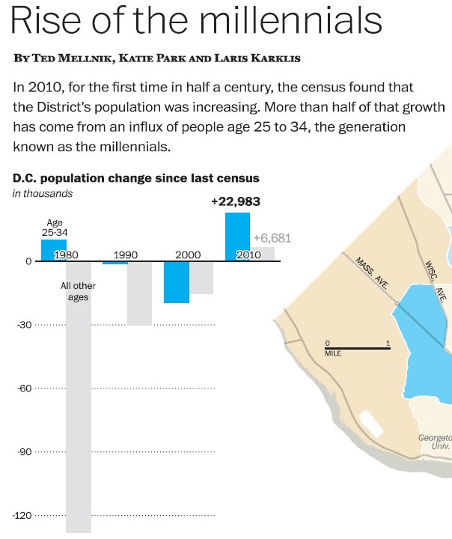

Slide 3
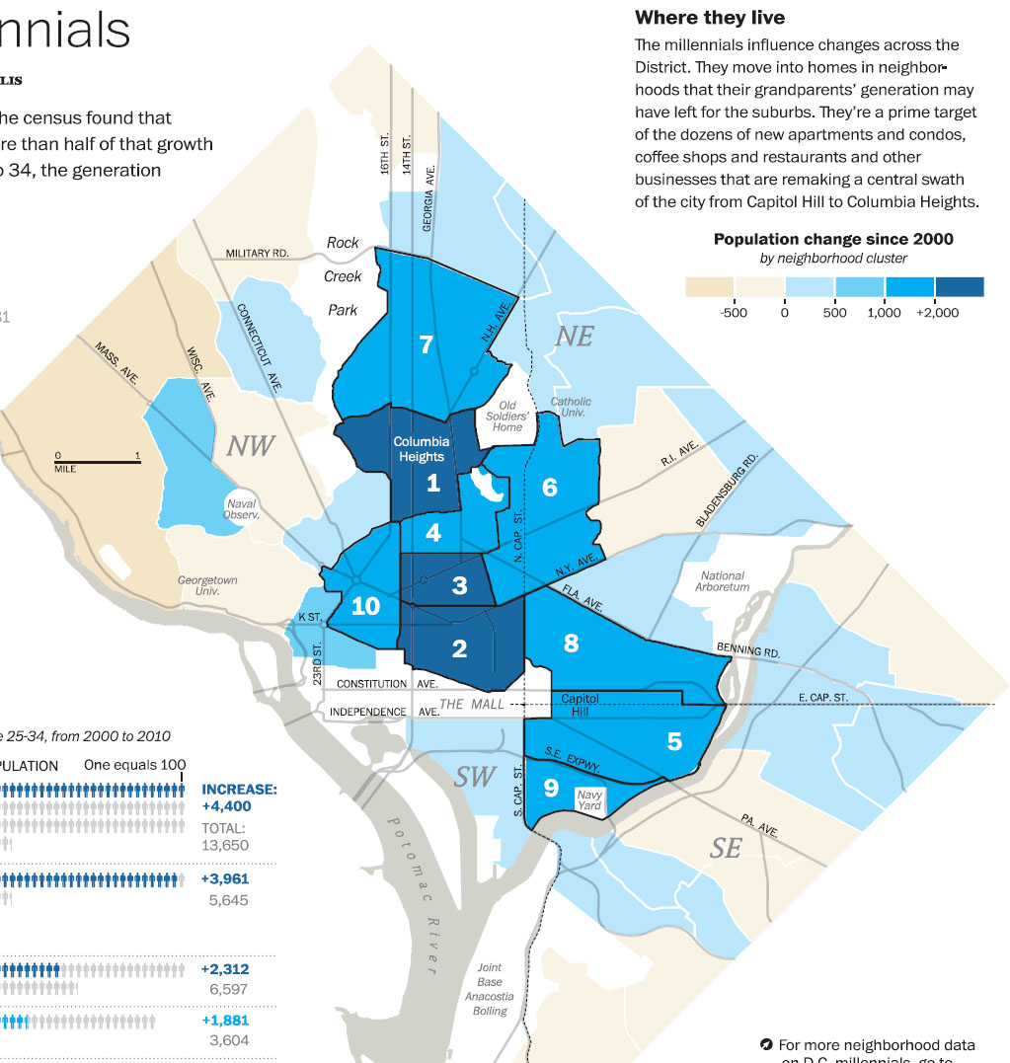

Slide 4
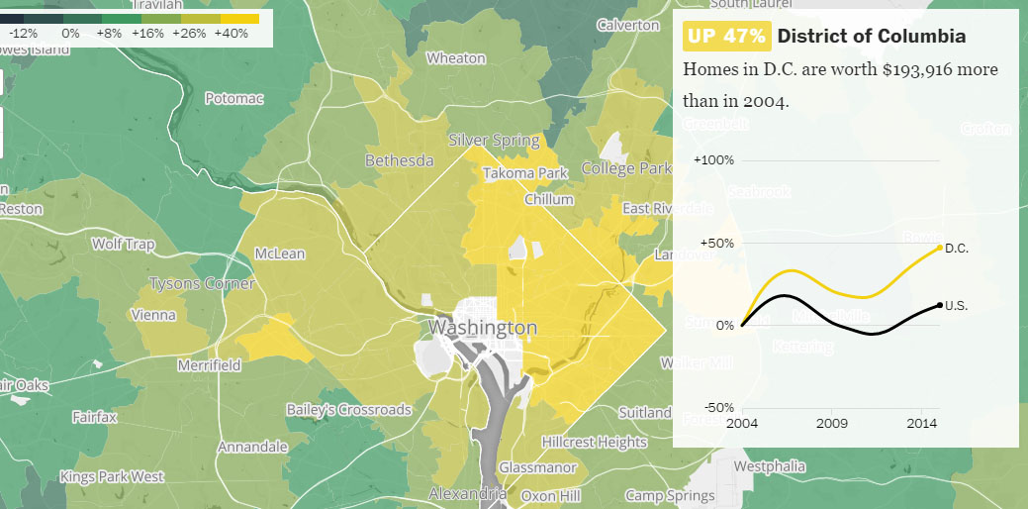

Slide 6
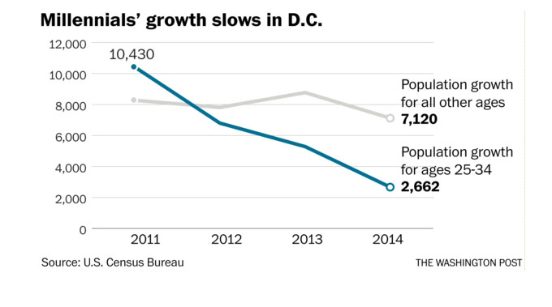

Slide 7
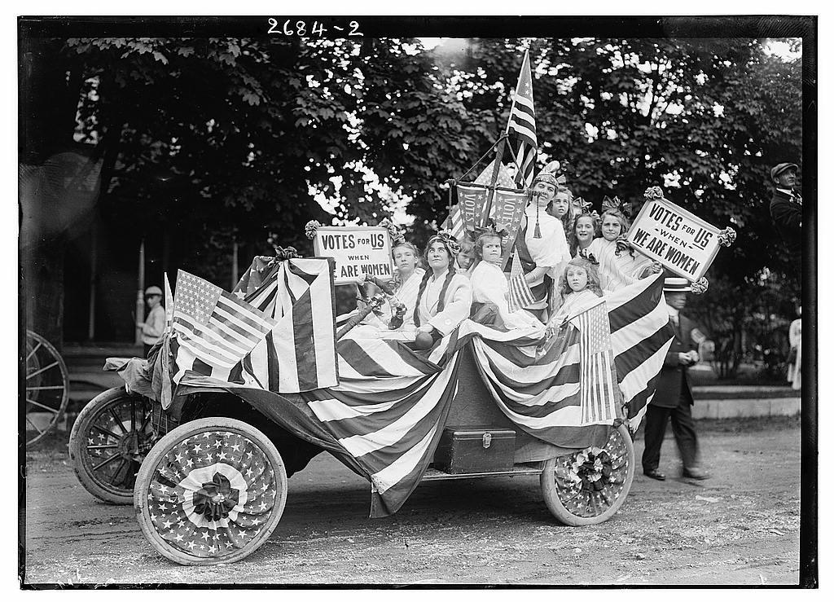

Slide 8
You need the practice.

Slide 9
Not Who.
How.

Slide 10
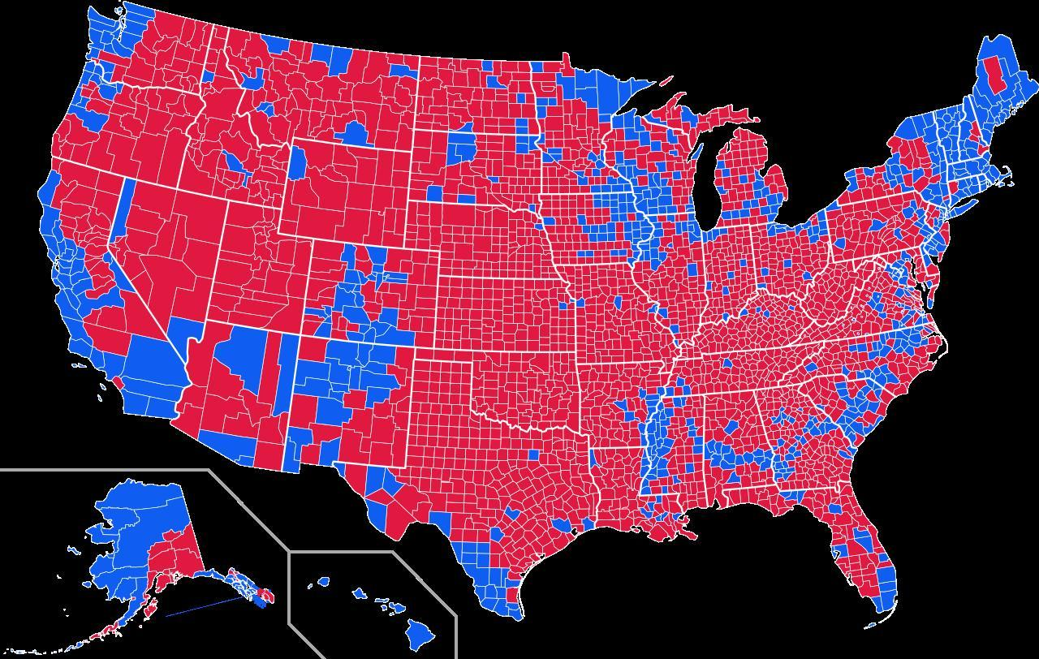
Do more than make a dumb map.

Slide 11
Make groups, summarize.
Geographic and political regions.
Census: urbanization, race, income.
Other elections, other candidates.

Slide 12
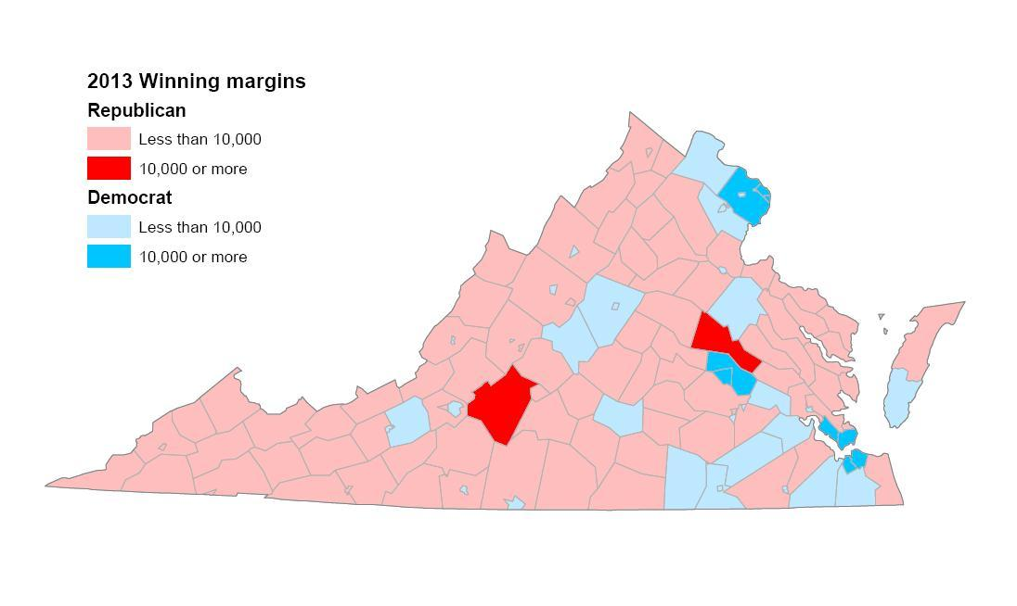
Original, dumb version.

Slide 13
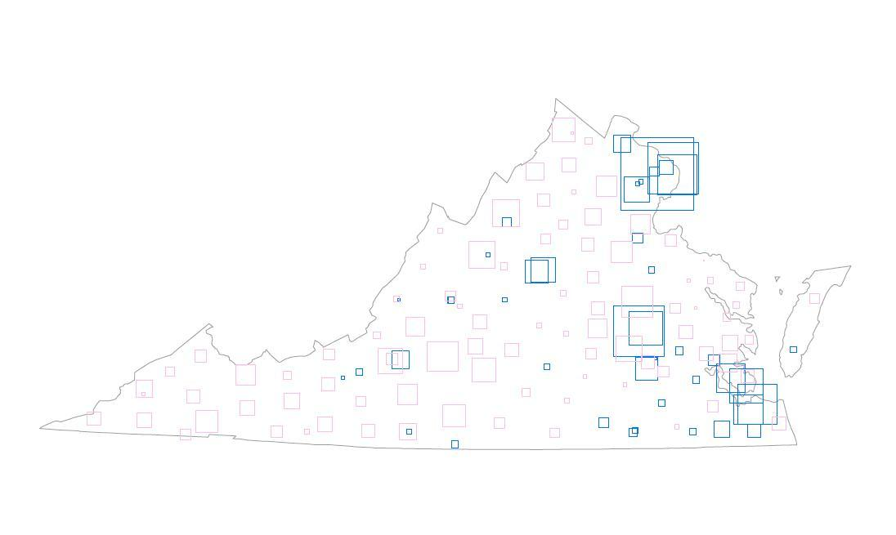
Proportional symbols.

Slide 14
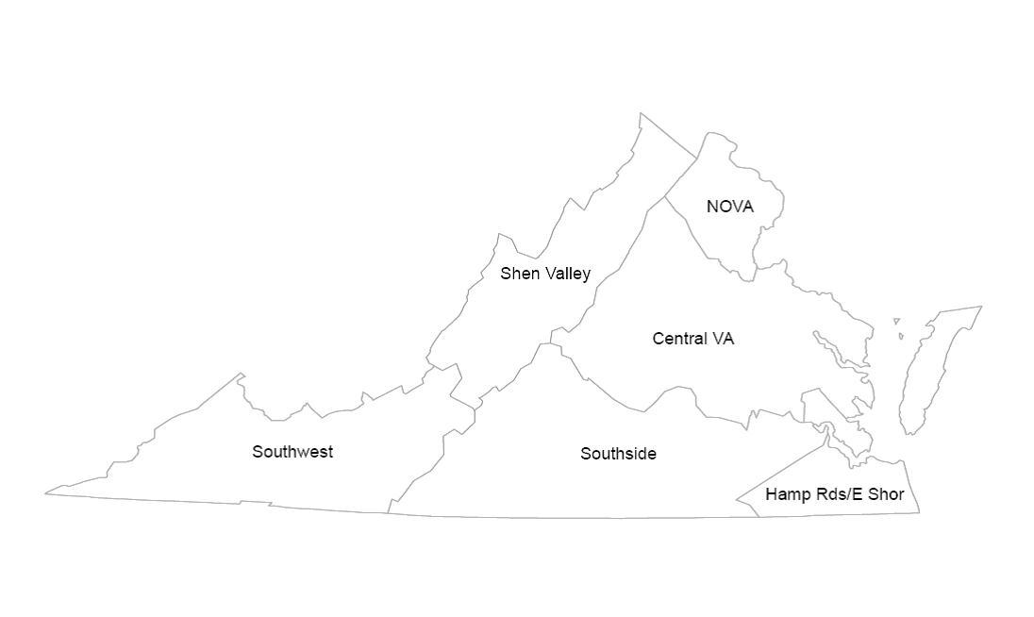
Regions.

Slide 15
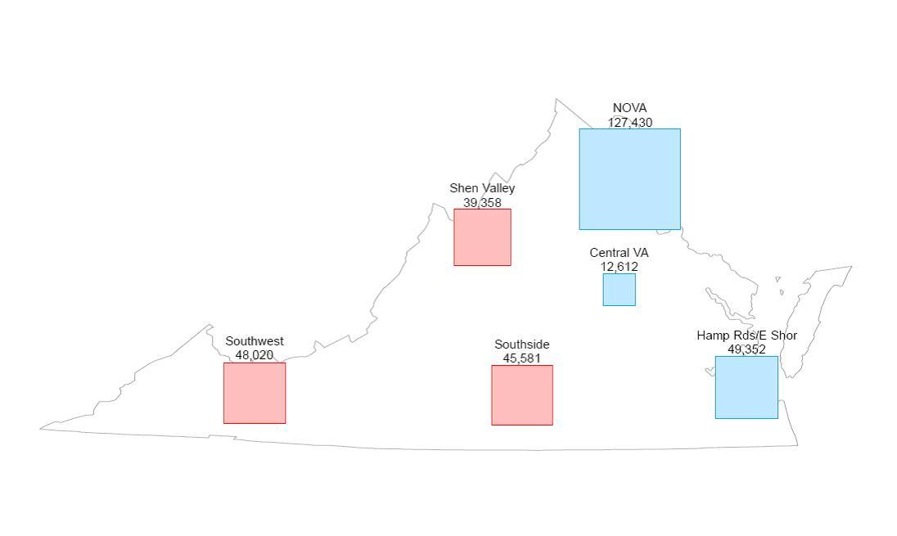
Regional symbols.

Slide 16
It helps to use a simple measure.

Slide 17
Urbanization.
Source: Census data for counties.
Percent population in urban and rural areas.
Status: Metro, micro, rural.
Population: Big, medium, small.
Some combination of the above.

Slide 18
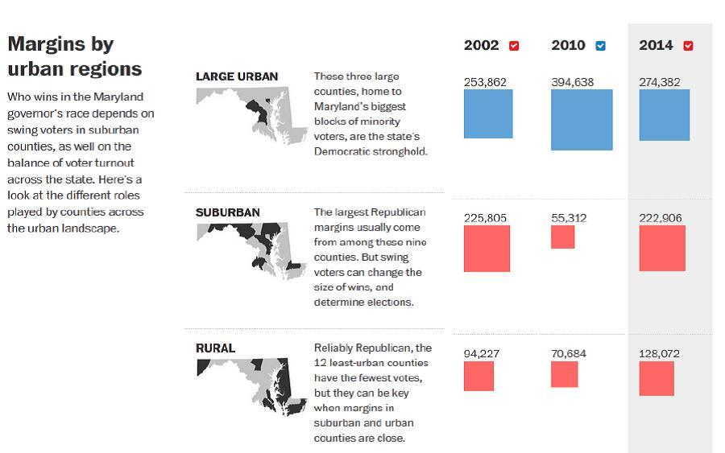

Slide 19
Go local.
Start with precincts for geography & data.
Regions.
Race.
Income.

Slide 20
Mayor margins in city council wards for a primary and a general election.

Slide 21
Race for precincts.
May be available from Census or a state or local redistricting office. Or,
Get block GIS files and data from Census.
Overlay precincts.
Sum blocks into the precincts they fall in.

Slide 22
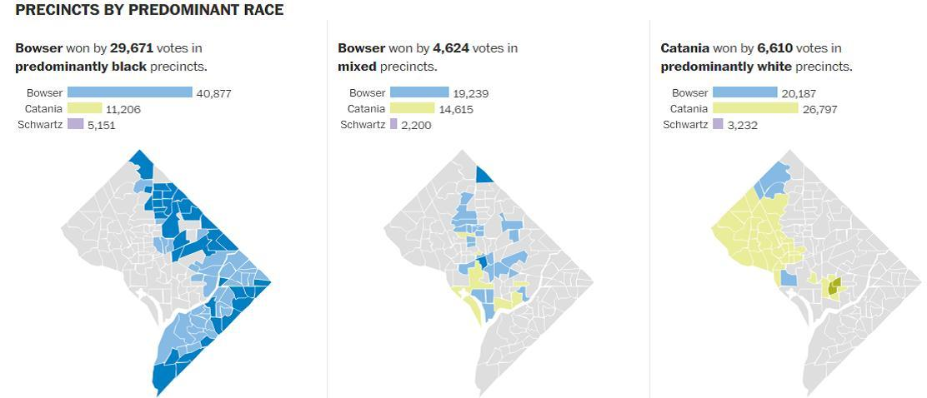
Don’t forget to visualize the subtotal, as well as precinct groups.

Slide 23
Voter history & registration.
Age.
Party.
Precinct.
Address.
Registration date.
Elections voted.

Slide 24
Age of voters in consecutive general elections.

Slide 25
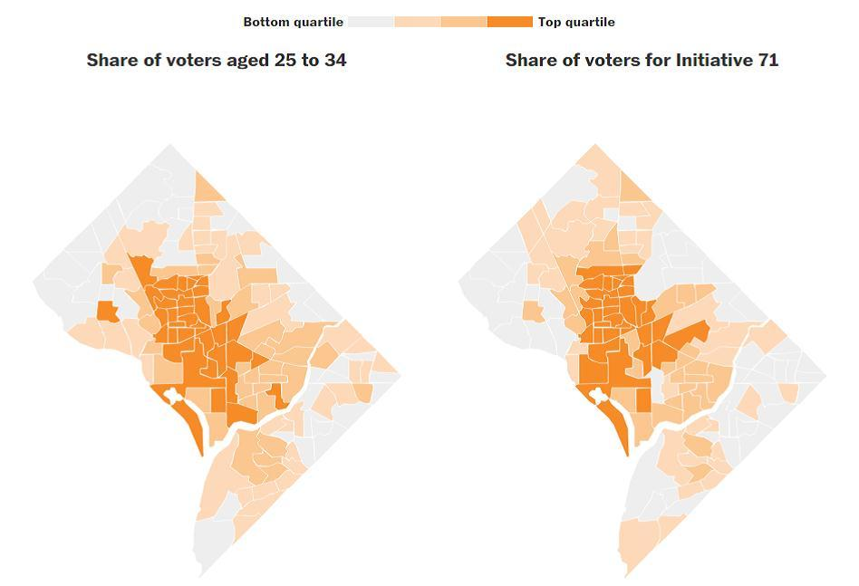

Slide 26
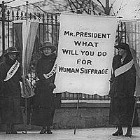

Slide 27
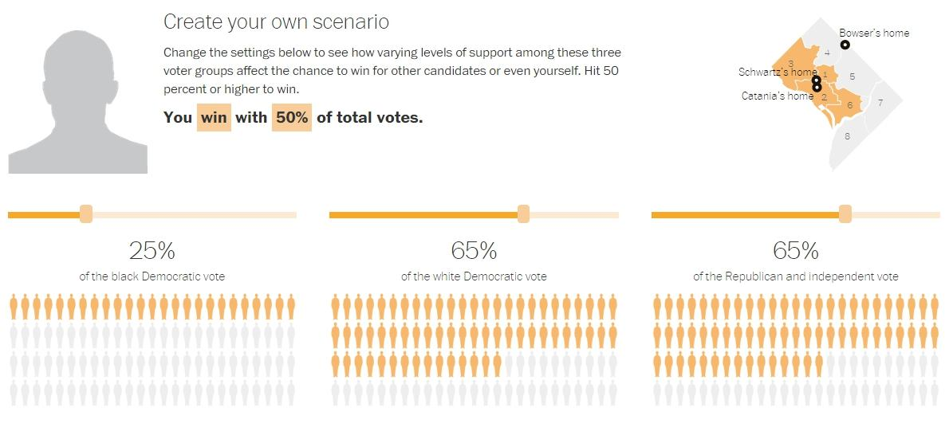
Move sliders to create a scenario based on voting history data.

Slide 28
http://www.washingtonpost.com/people/ted-mellnik

